Slide 1
SAP BTP/CAP - DAY 02 : Understanding SAP BAS
Day 2: Create Your First CAPM App using SAP BAS

Slide 2
Training Agenda of Day 02
Understanding the SAP BTP Cockpit and Configuration
Explain the CAP (Cloud Application Programming)
Demonstrate how to add modules in `package.json`, install CAP CLI, and initialize CAP project using `cds init`
Create a simple CAP service using CDS model and service definitions
Define CDS, Services, and Handlers in CAPM
Explain `package.json` and adding dependencies from npm

Slide 3
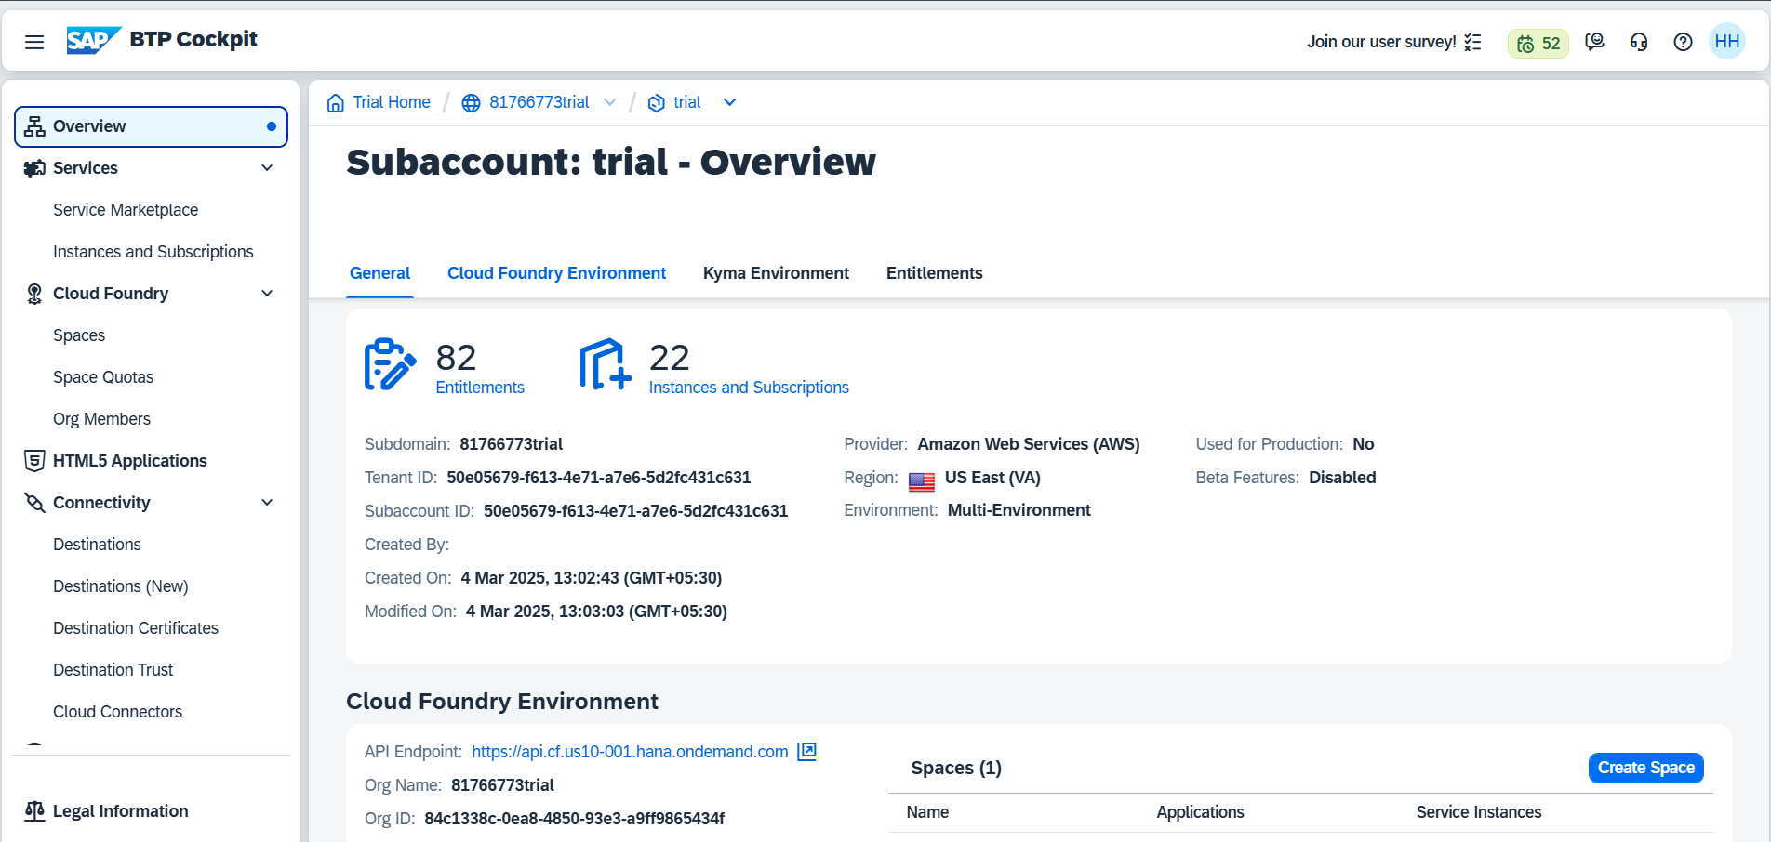
SAP BTP : Cockpit

Slide 4
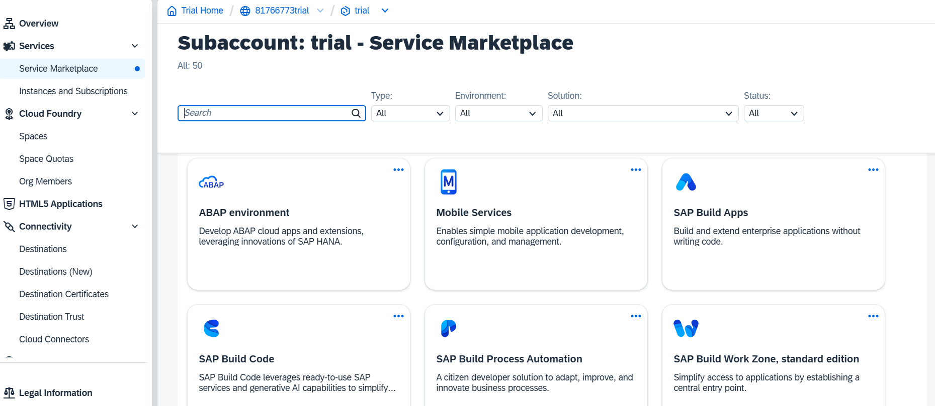
SAP BTP : Marketplace

Slide 5
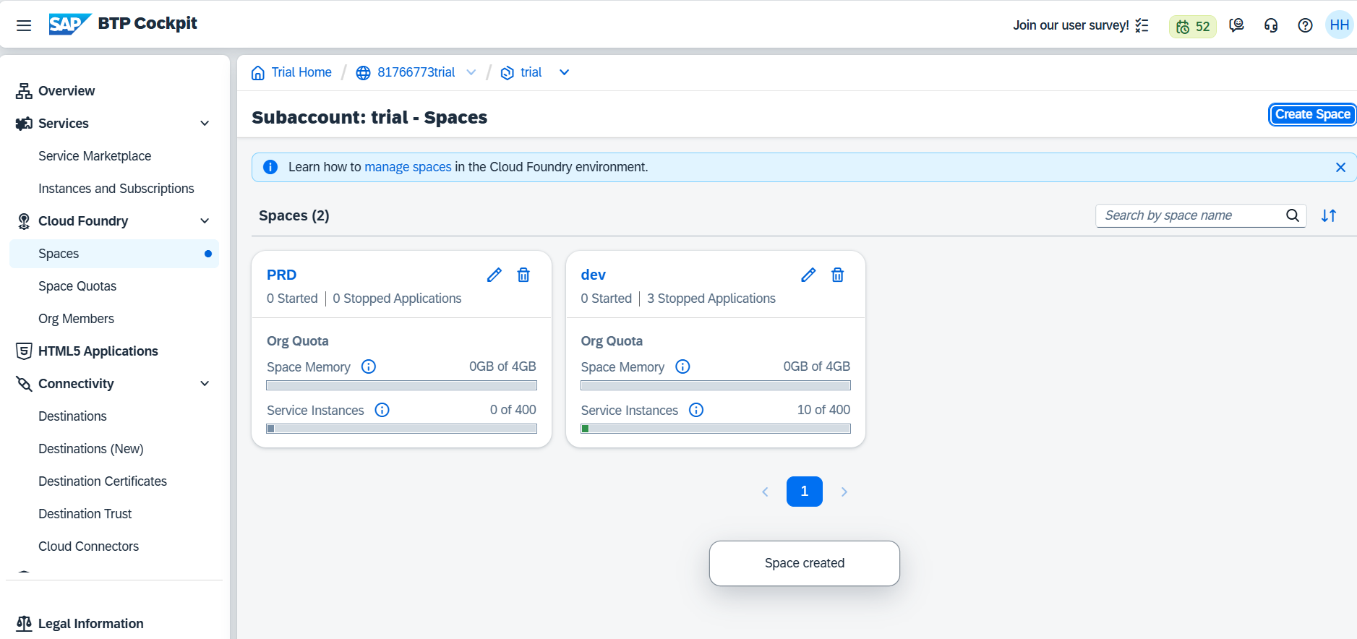
SAP BTP Cloud Foundry : Spaces & Org Members

Slide 6
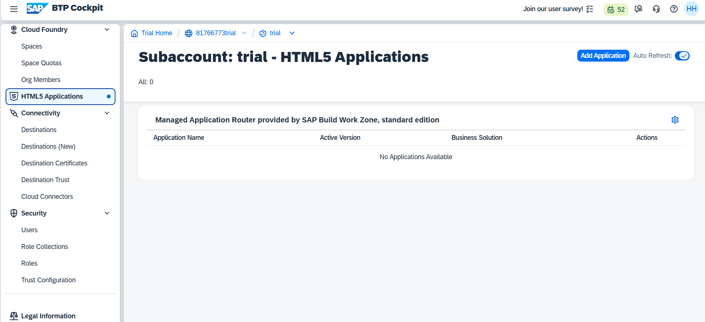
SAP BTP : HTML5 Application/SAP Workzone

Slide 7
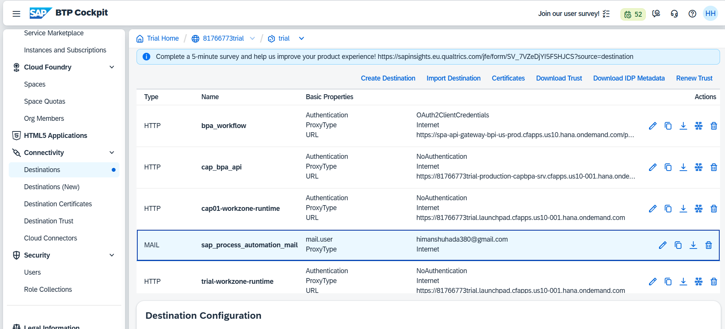
SAP BTP : Connectivity & Destinations

Slide 8
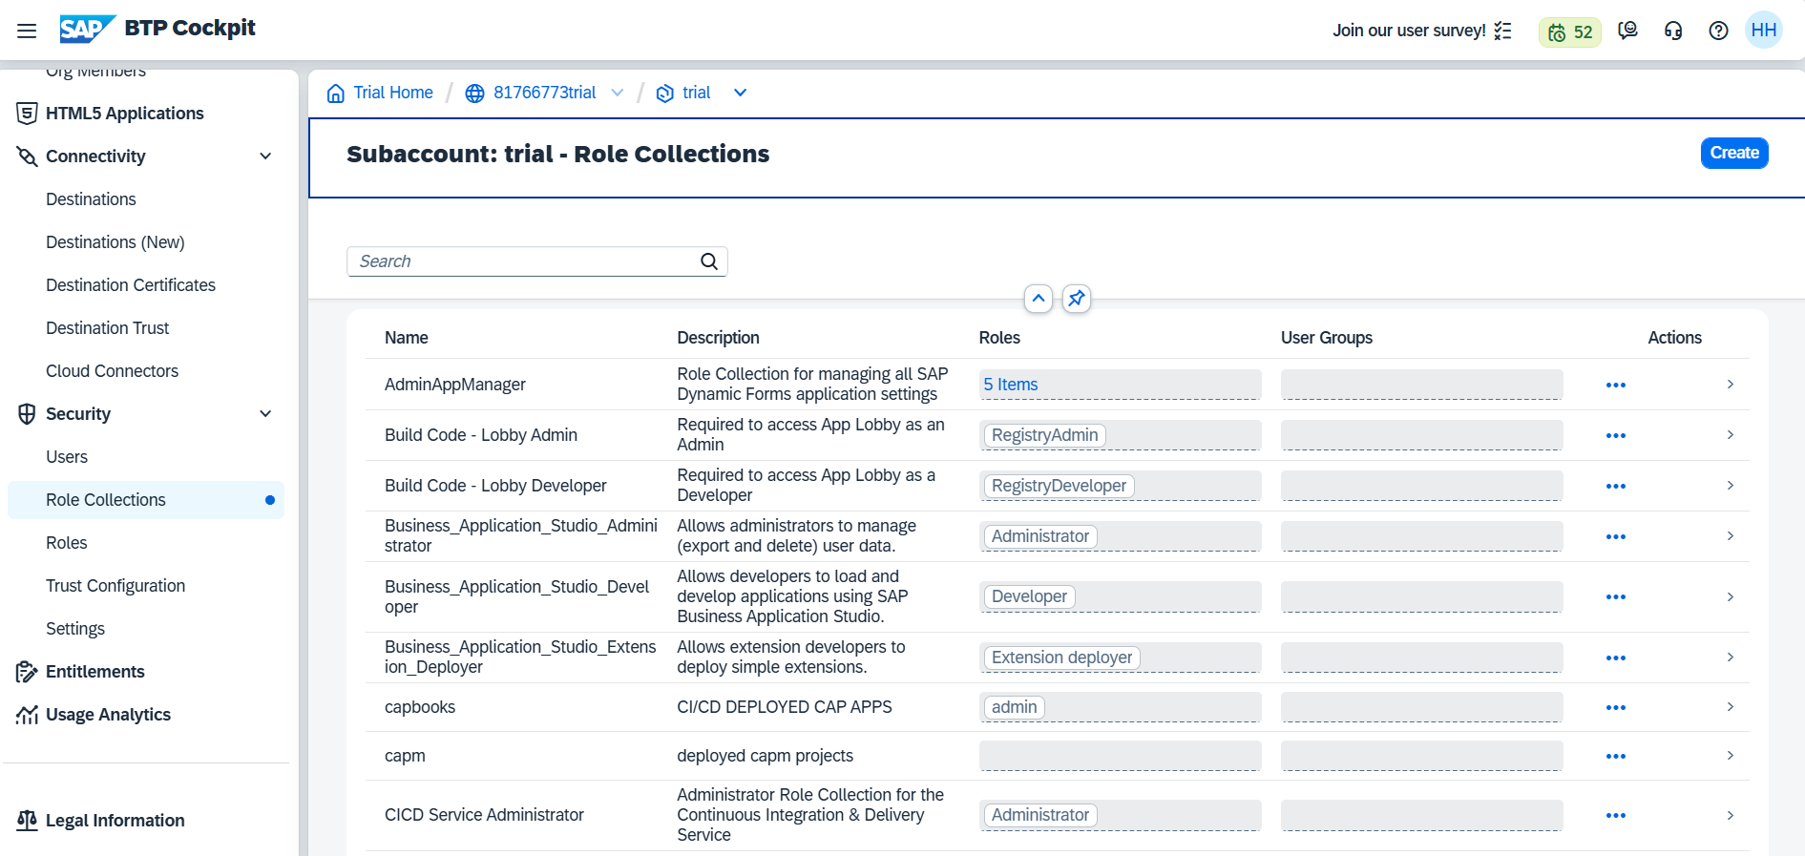
SAP BTP : Security & User Roles

Slide 9
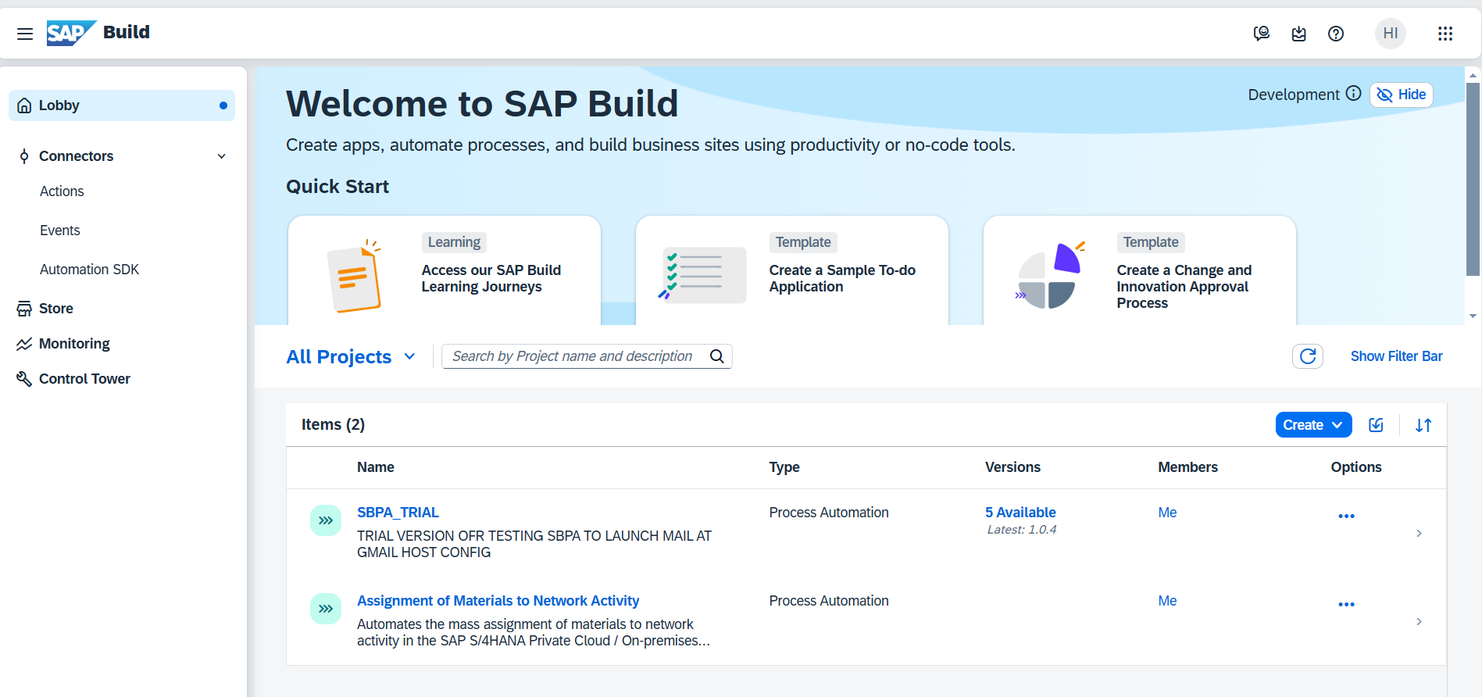
SAP Build Lobby

Slide 10
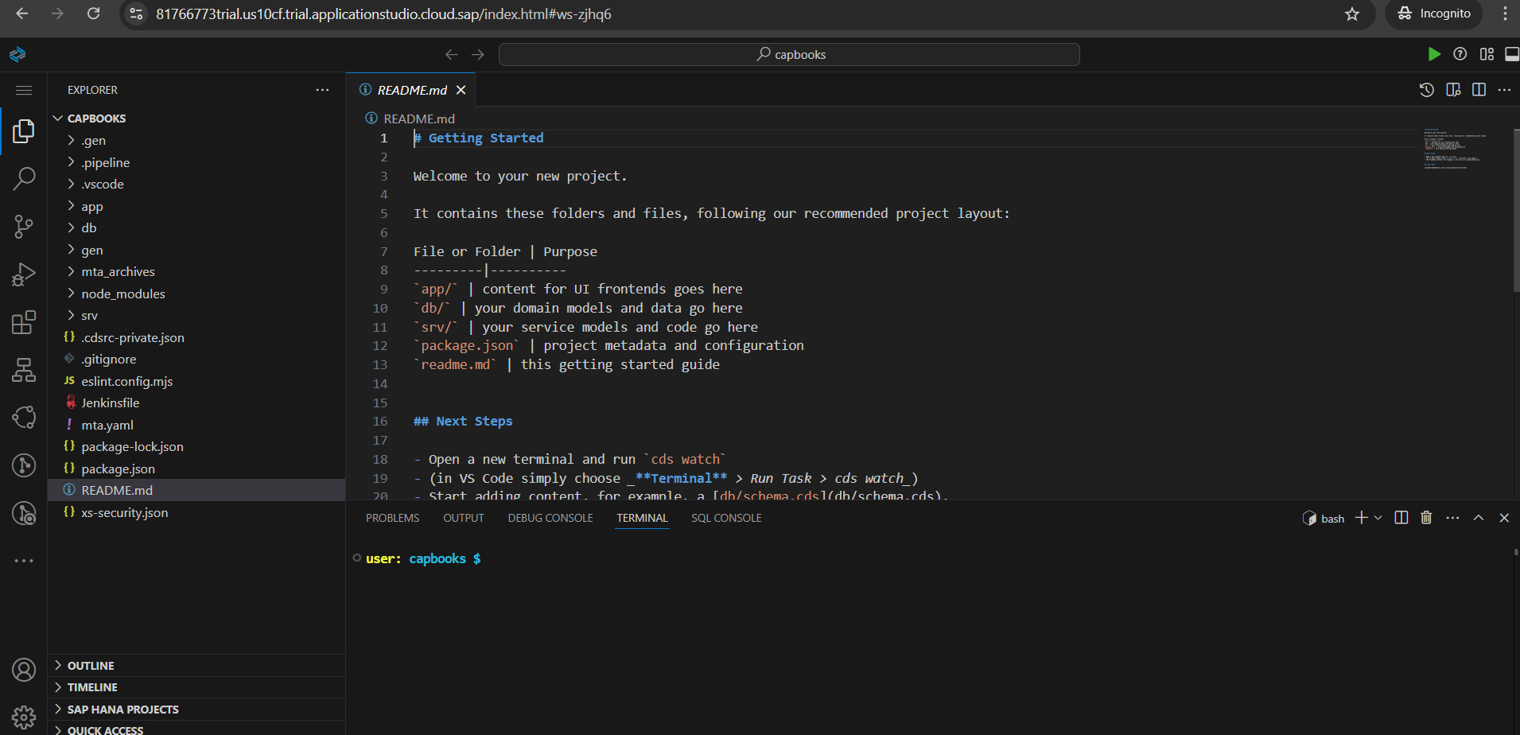
SAP BTP : BAS Studio ( VS Code ENV )

